Slide 1
COEN 275 Object-Oriented Analysis, Design and Programming (4 units)
Paddu Melanahalli
pmelanahalli@scu.edu
School of Engineering/Graduate Engineering

Slide 2
Software Development
A software development methodology or system development methodology in software engineering is a framework that is used to structure, plan, and control the process of developing an information system.
An information system (IS) - is any combination of information technology (IT) and people's activities that support operations, management and decision making.
Waterfall methodology - The waterfall methodology is a linear project management approach, where stakeholder and customer requirements are gathered at the beginning of the project, and then a sequential project plan is created to accommodate those requirements. The waterfall model is so named because each phase of the project cascades into the next, following steadily down like a waterfall. Requirements, Design, Implementation, Verification, Maintenance
Agile methodology - The agile methodology differs greatly from the waterfall approach in two major ways; namely in regard to linear action and customer involvement. Agile is a nimble and iterative process, where the product is delivered in stages to the customer for them to review and provide feedback.
Instead of having everything planned out by milestones, like in waterfall, the Agile software development method operates in “sprints” where prioritized tasks are completed within a short window, typically around two weeks.
These prioritized tasks are fluid and appear based on the success of previous sprints and customer feedback, rather than having all tasks prioritized at the onset in the requirements phase.

Slide 3
Software development methodology
Software development life cycle ( SDLC) model
Waterfall / V- Model
Spiral model
Agile
Object oriented model
Re-usability – objects and components (easy to integrate)
Component based software development
Shorter development time
Build your own process and model
Understand the situation
Map your process
Bottlenecks and opportunities
Complex issue first and then work your way down
Options for improvements

Slide 4
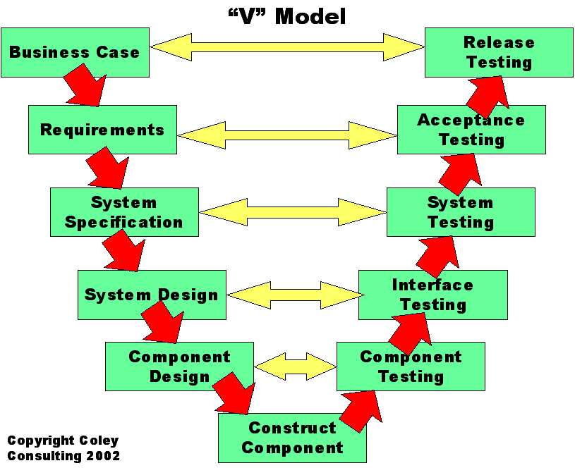
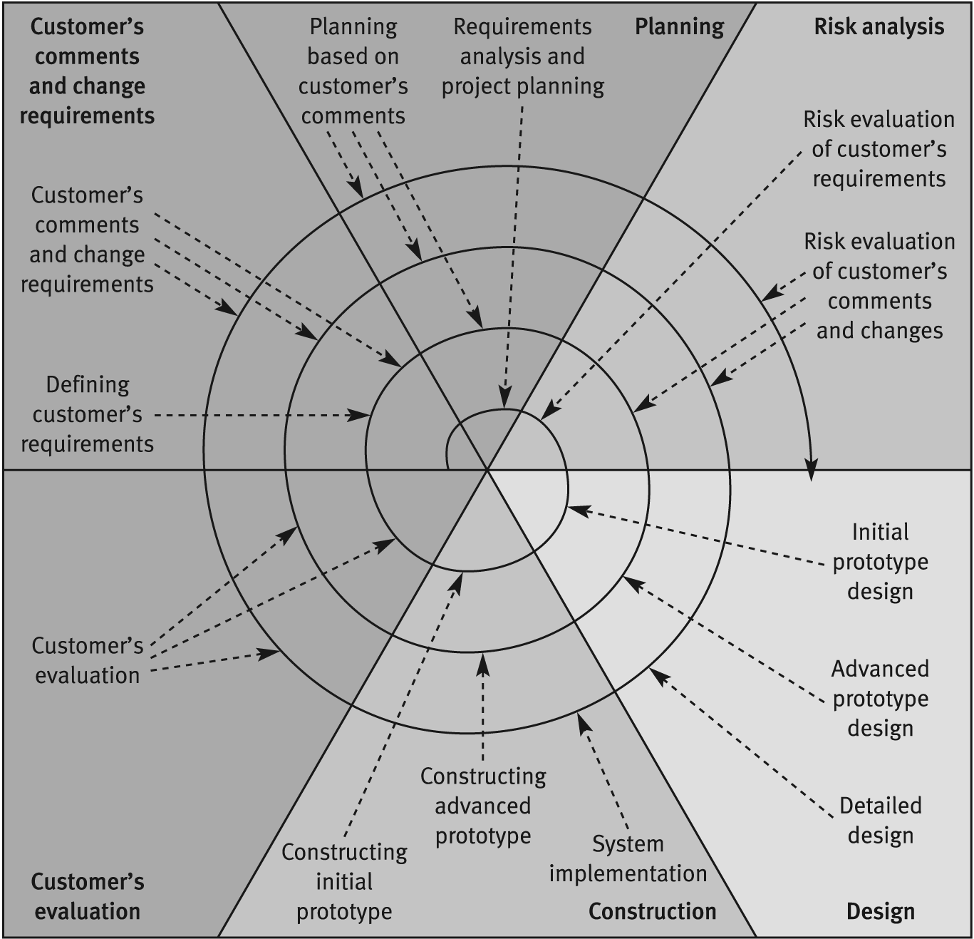
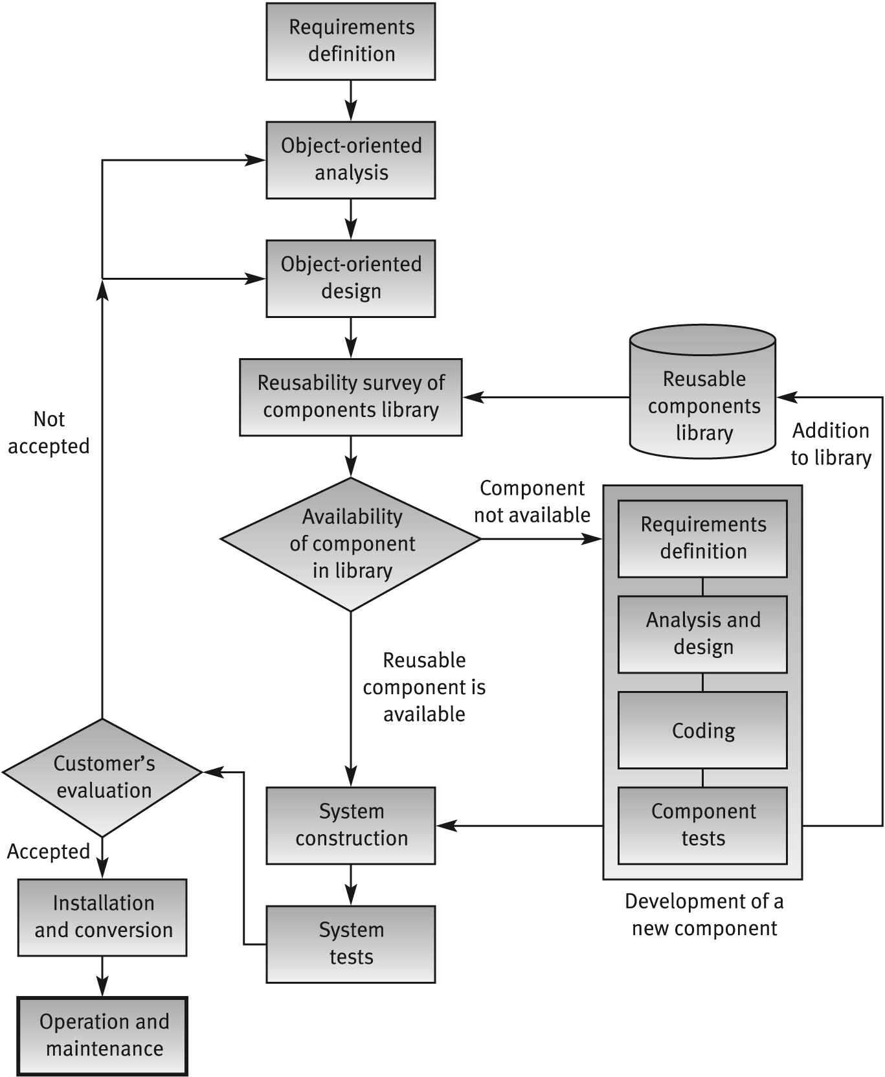
Models
Waterfall/V shaped model
Spiral model
OO model

Slide 5
Waterfall Methodology
Requirements & Documentation | System Design | Execution | Testing and Deployment | Maintenance | Tools | Risks
Project scope | Understand the functionality | Team formation with skill set | Verification & validation | Customer feedback | Gantt chart | Dependency
Stake holders' management | Collecting tasks and components | Assign, monitor and track, development | Test cycles | Defects and fixes | Spreadsheets | New requirements & change requests
research | Create schedule | Resource & workload | Early field trials | Patch and release management | Wiki/dashboards | Design change - complications
Team formation |  | Reports & testing | Automation |  |  | Rigidity and surprises
Kick off |  | Delivery

Slide 6
Agile Methodology
Manifesto for Agile Software Development (4 core values)
Individuals and interactions over processes and tools
Working software over comprehensive documentation
Customer collaboration over contract negotiation
Responding to change over following a plan
That is, while there is value in the items on the right, we value the items on the left more.”
12 Agile principles
Satisfy Customers Through Early & Continuous Delivery
Welcome Changing Requirements Even Late in the Project
Deliver Value Frequently
Break the Silos of Your Project
Build Projects Around Motivated Individuals
The Most Effective Way of Communication is Face-to-face
Working Software is the Primary Measure of Progress
Maintain a Sustainable Working Pace
Continuous Excellence Enhances Agility
Simplicity is Essential
Self-organizing Teams Generate Most Value
Regularly Reflect and Adjust Your Way of Work to Boost Effectiveness

Slide 7
Good Practice in software development
The code should be modular, procedure/functions can help
Meaningful variables should be used
In-line comments are recommended, explaining the function of each segment of the code is needed
Complex algorithm – make it simple and explain for maintainability
Always provide function descriptions, input and output details
Keep revisiting and refining the design and structure of the code
Dry-run – works through a section of program code by hand, useful to locate the errors, may be tracing table!
Test for positive, negative and error/exceptions cases
Test boundary conditions
Test corner cases
User responsiveness, availability, performance and scale are super important
Inline documentation - user guide/install/system requirements - is always helpful

Slide 8
Thank You!

